Slide 1






RAVI J SINGH
Founder & CEO
_______________
T raloda
Travel. Love. Date.
www.traloda.com
RAVI J SINGH
Founder & CEO
_______________
T raloda
Travel. Love. Date.
www.traloda.com
RAVI J SINGH
Founder & CEO
_______________
T raloda
Travel. Love. Date.
www.traloda.com
+91 8377015140
+91 8377015140
+91 8377015140
ravi@traloda.com
ravi@traloda.com
ravi@traloda.com
T raloda
Travel. Love. Date.
RAVI J SINGH
Founder & CEO
_______________
T raloda
Travel. Love. Date.
www.traloda.com
+91 8377015140
ravi@traloda.com
RAVI J SINGH
[ Founder & CEO ]
ravi@traloda.com
+91 8377015140
www.traloda.com
Gurgaon, Haryana

Slide 2


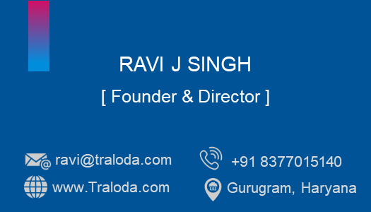



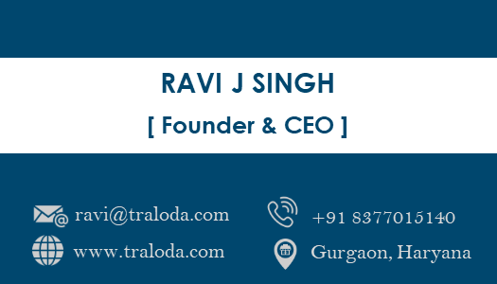
T raloda
Travel. Love. Date.

